Slide 1

KIWI.COM TRAVEL HACK September 29th, 2019

Slide 2
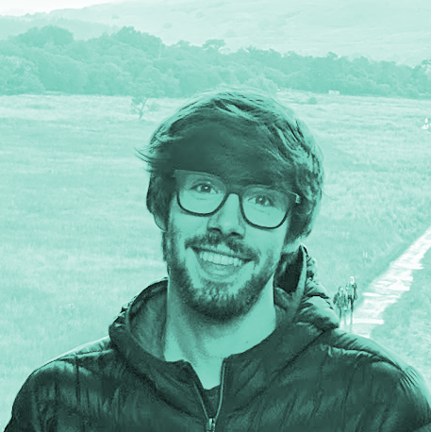



The Team
Brais, Front-end
Moises, Full-stack
Sam, Full-stack
Mina, UX Design

Slide 3

Users First

Slide 4

Pepe, 29 BARCELONA
Pepe is a very active person, he owns a restaurant in the city and is always busy at work or out with friends.
He loves to travel.

Slide 5
Pepe, 29 BARCELONA
He’s also happens to have a broken arm.
How is it affecting his travel plans?

Slide 6
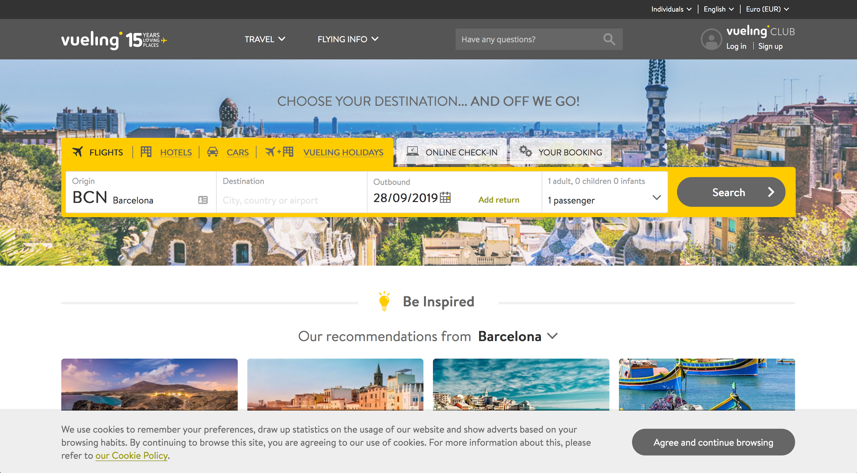
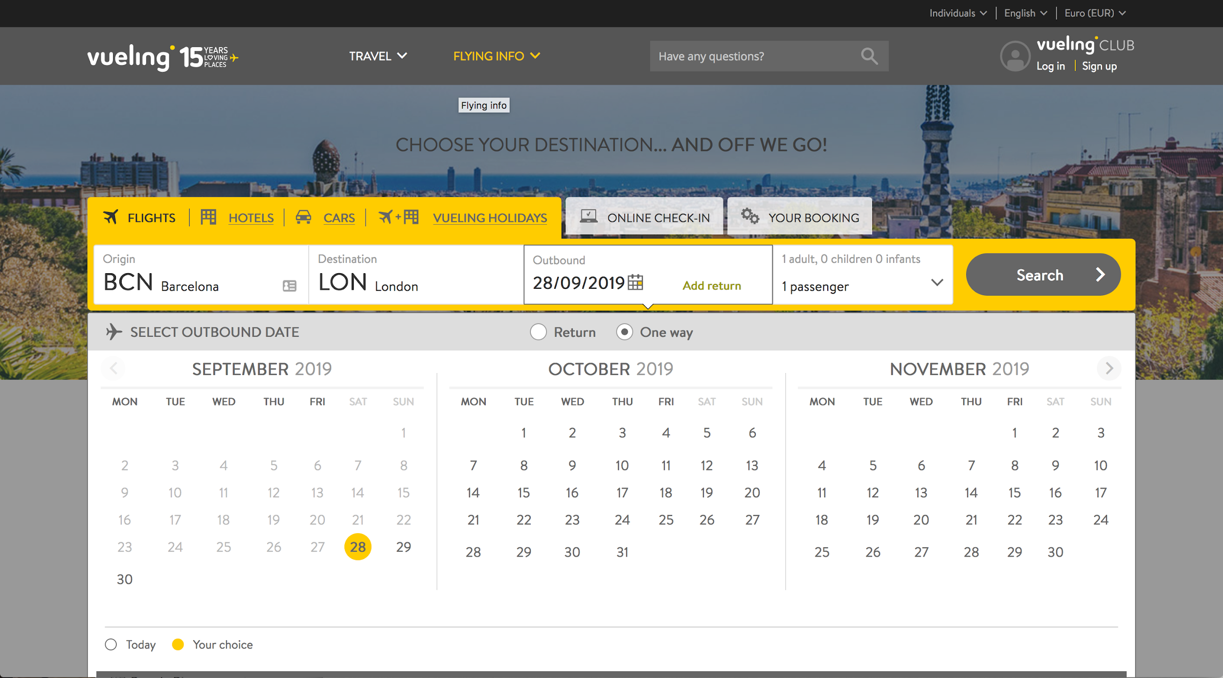
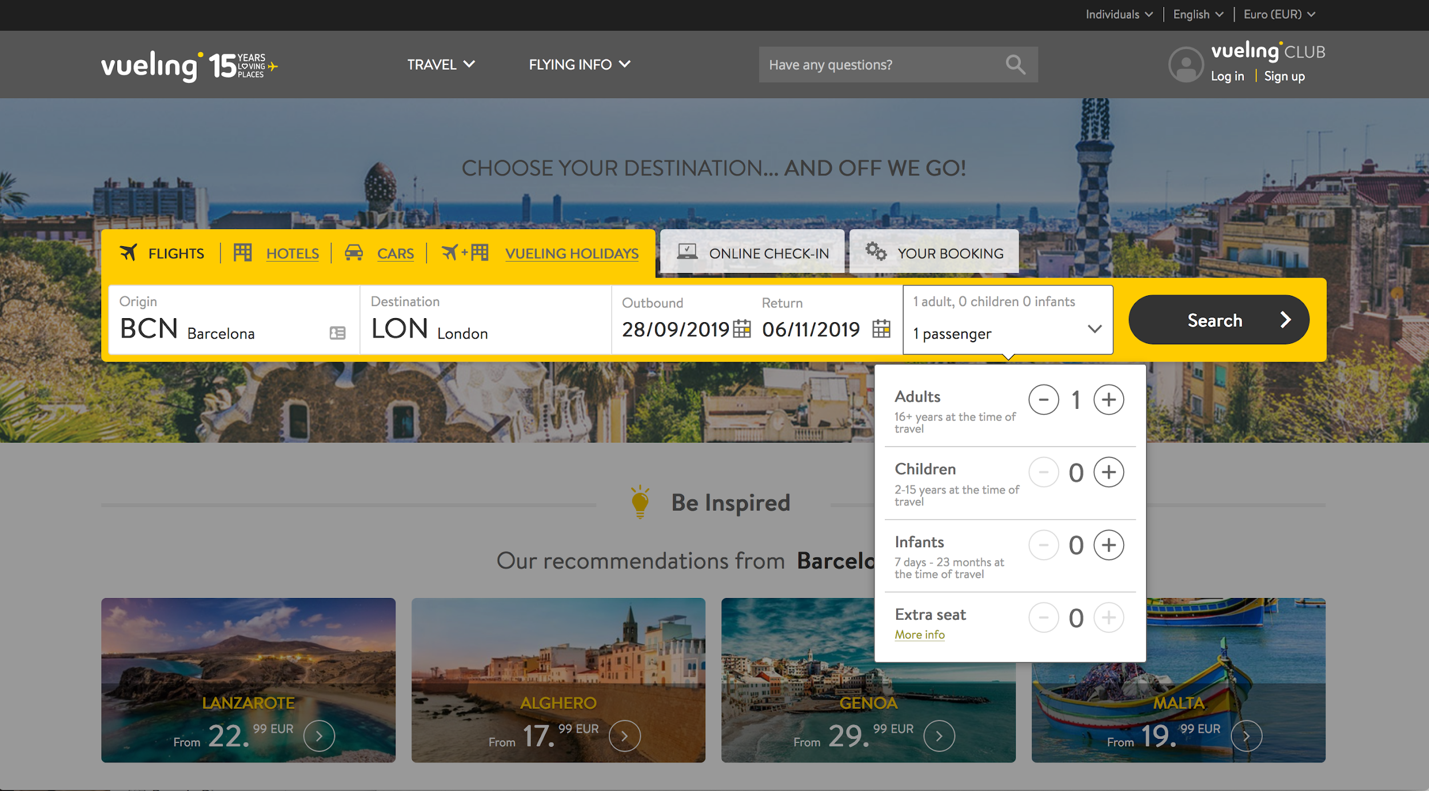
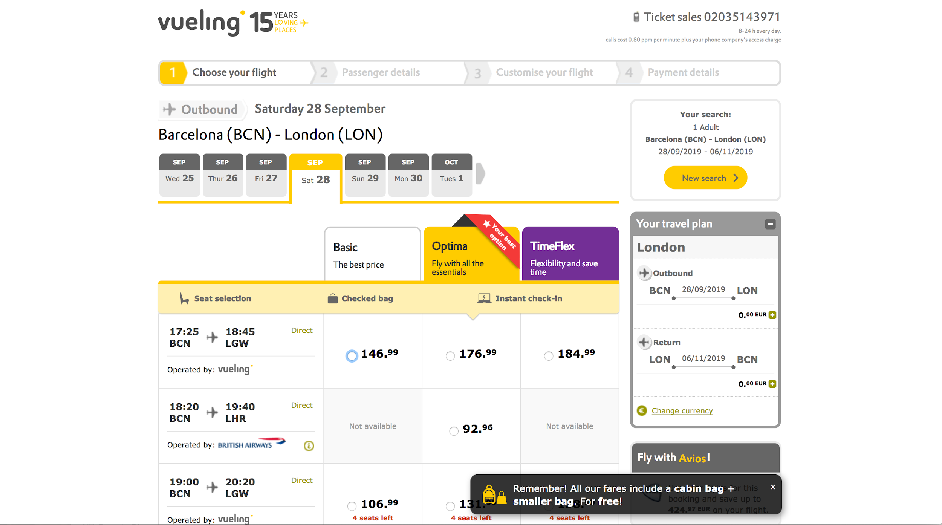
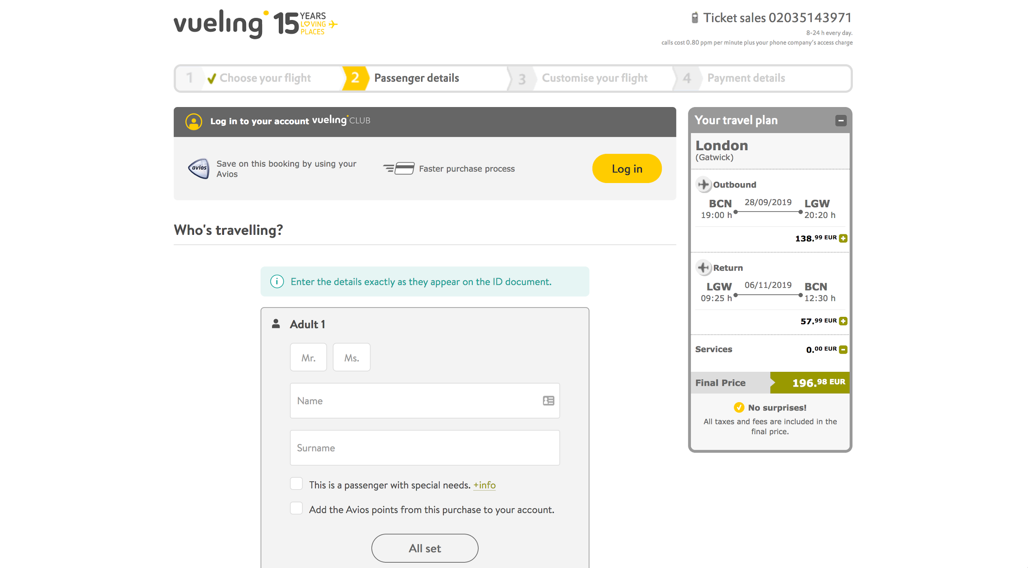
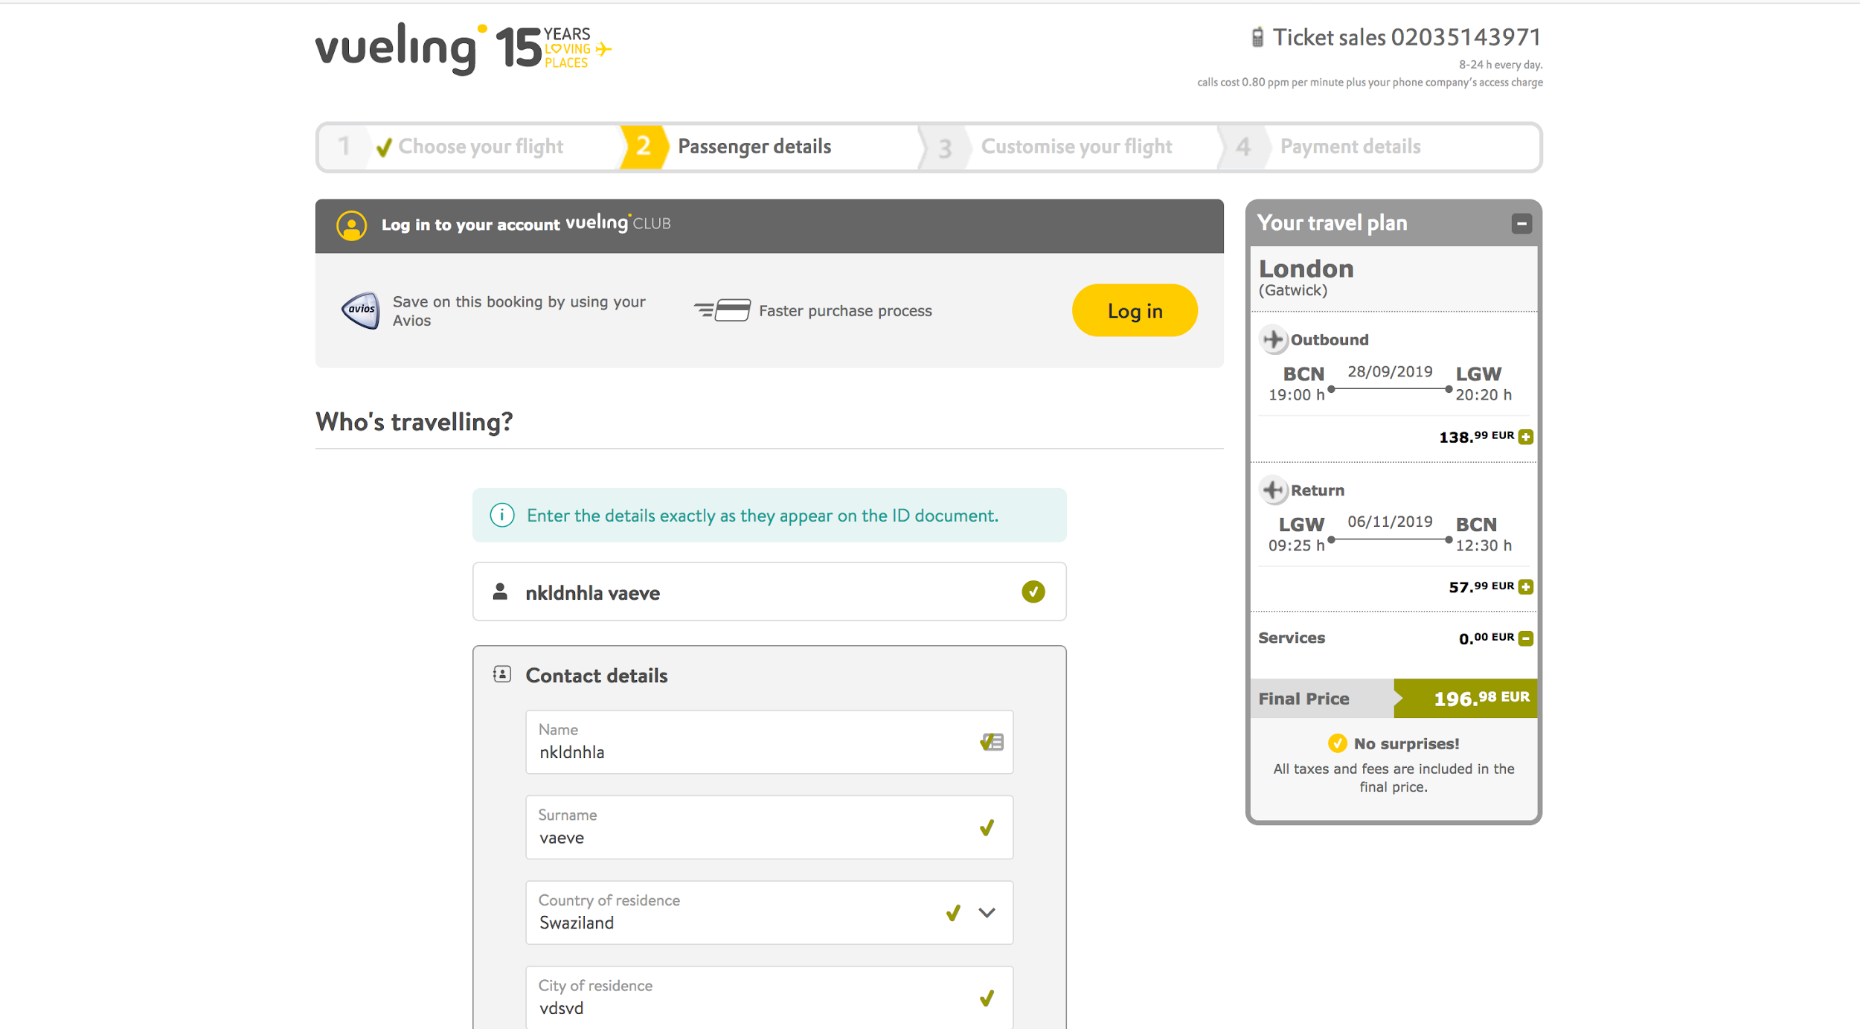
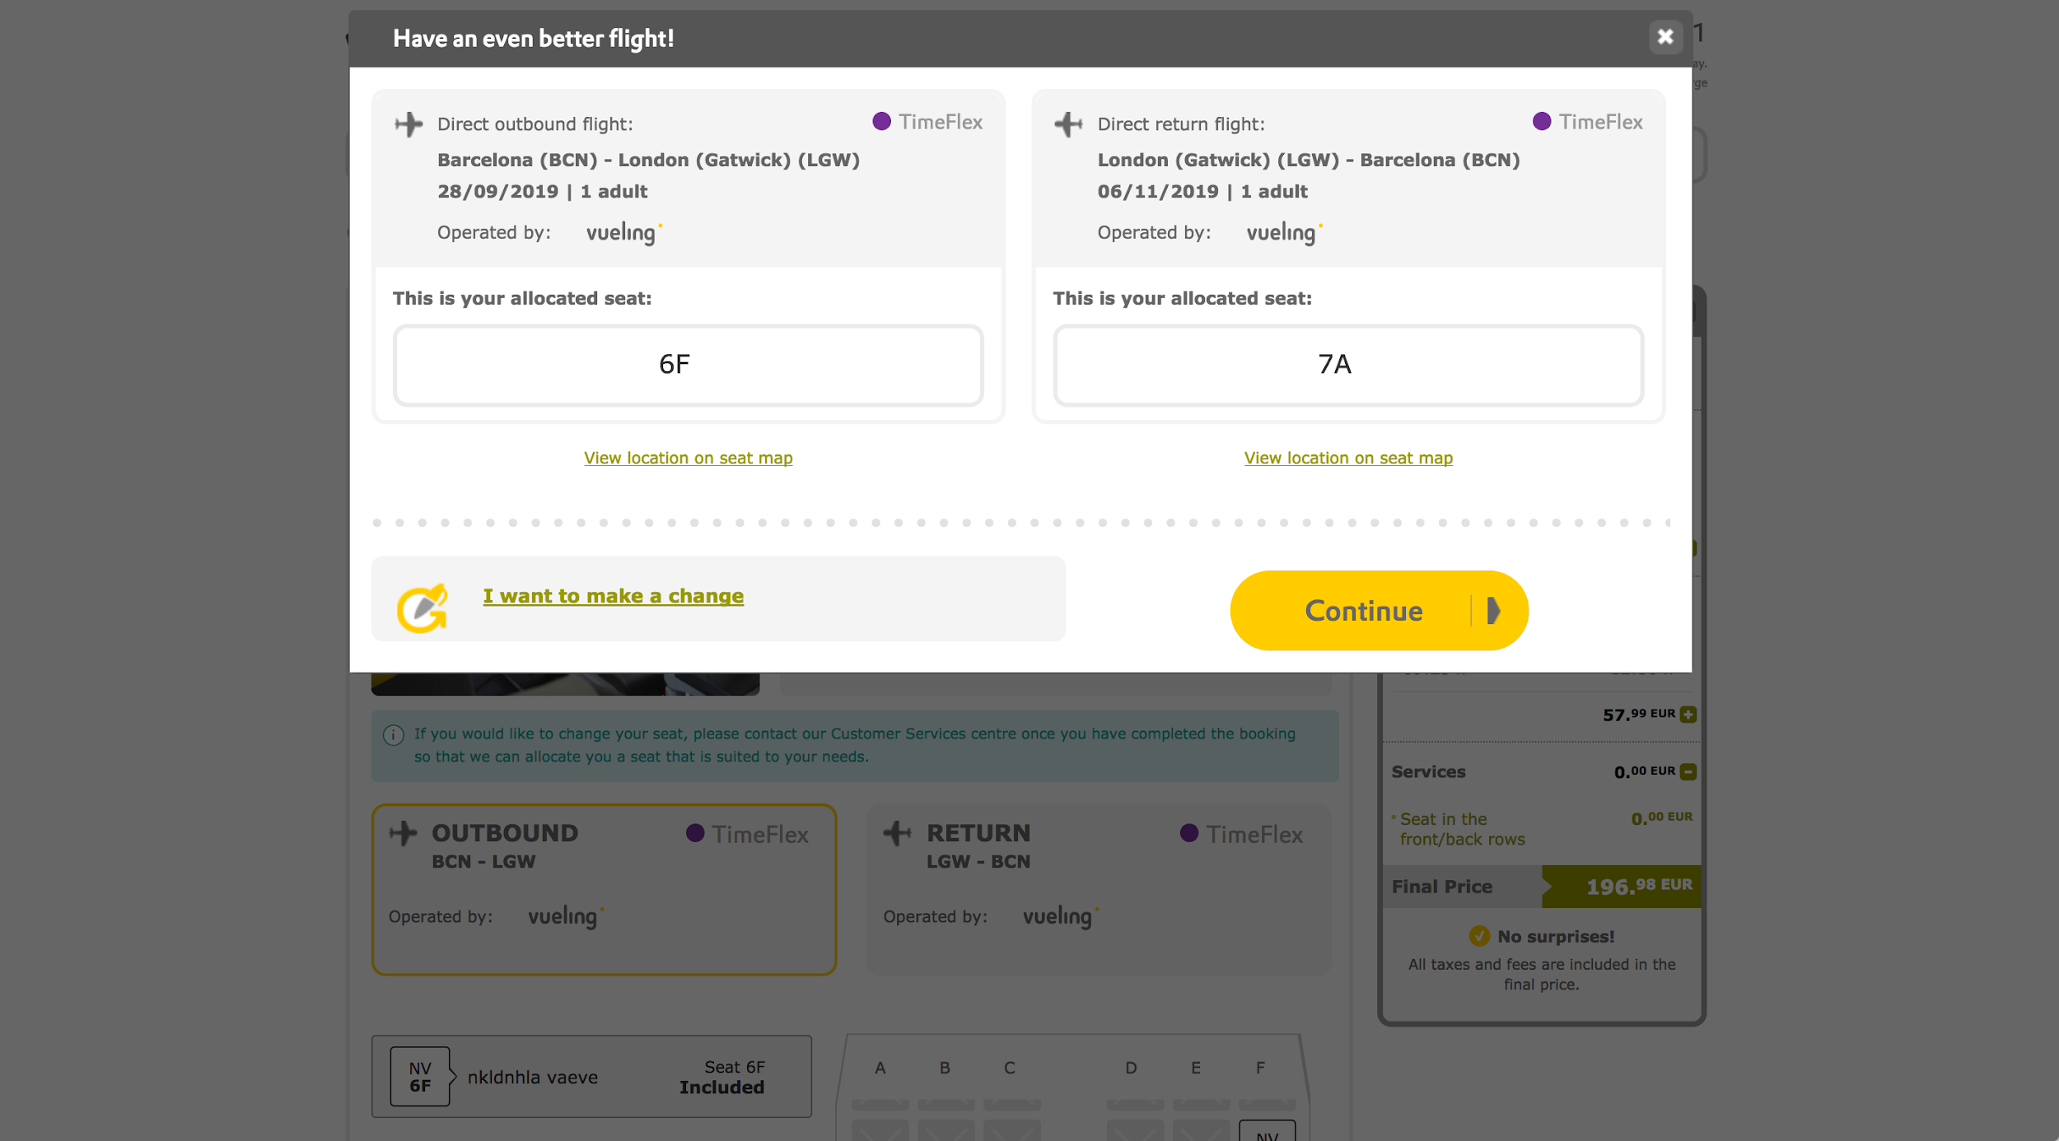
USER PROBLEM
Accessibility
Notes:
Add funnel visualadd source of data

Slide 7
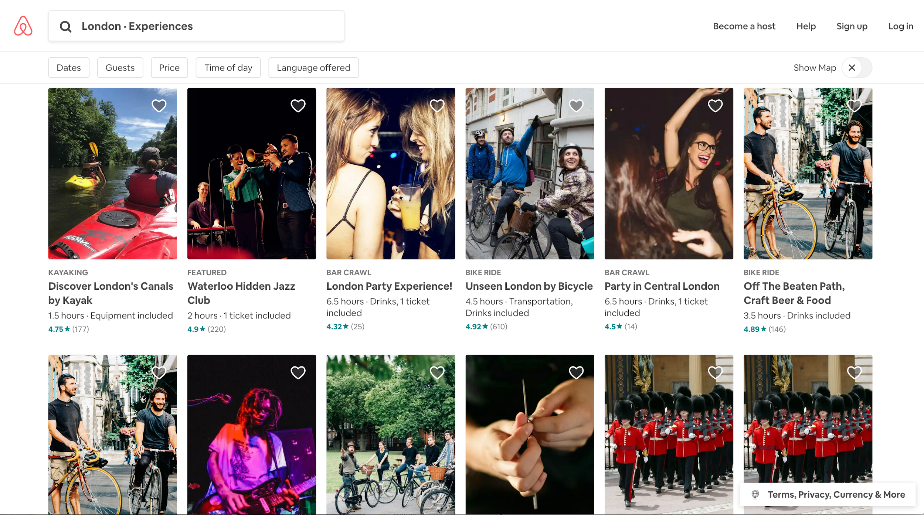
USER PROBLEM
Accessibility
Notes:
Add funnel visualadd source of data

Slide 8
USER PROBLEM
Accessibility
Notes:
Add funnel visualadd source of data

Slide 9
Why should Pepe’s disability affect his love for travel?

Slide 10
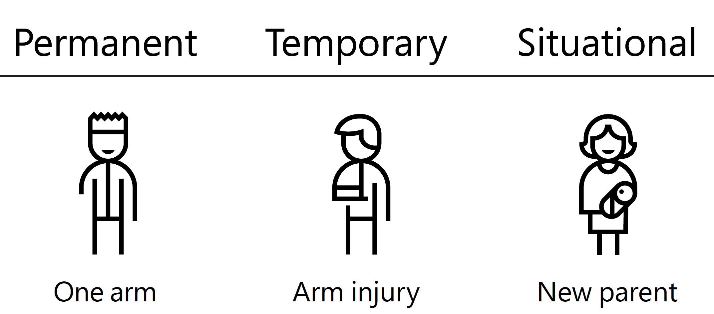
And it’s not just Pepe...
Notes:
Not only for PEPE but

Slide 11

Conversational UI

Slide 12
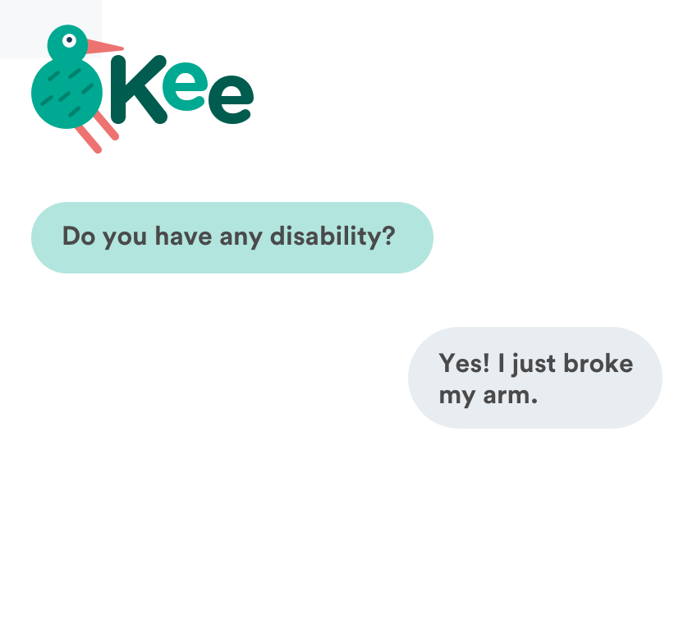
Set your preferences once and Kee applies it to your whole journey.
Notes:
Conversational UI can be used by voice (fhands free, both arms broken, cooking, in the car)
Or by choosing options (mudo)
Que ensenye como te pide tus accessibility settings, just one time , take advantage every step of the journey
Future trips or same trip
Tal vez estaria bien anyadir a la slide texto de “set your dissabilities once, and its there for the whole journey and future whatever

Slide 13
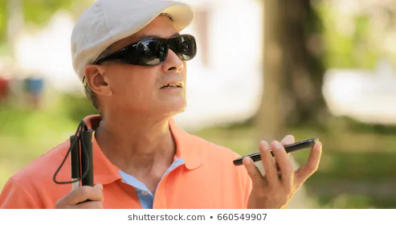
Notes:
Conversational UI can be used by voice (fhands free, both arms broken, cooking, in the car)
Or by choosing options (mudo)
Que ensenye como te pide tus accessibility settings, just one time , take advantage every step of the journey
Future trips or same trip
Tal vez estaria bien anyadir a la slide texto de “set your dissabilities once, and its there for the whole journey and future whatever

Slide 14

Notes:
Conversational UI can be used by voice (fhands free, both arms broken, cooking, in the car)
Or by choosing options (mudo)
Que ensenye como te pide tus accessibility settings, just one time , take advantage every step of the journey
Future trips or same trip
Tal vez estaria bien anyadir a la slide texto de “set your dissabilities once, and its there for the whole journey and future whatever

Slide 15
Notes:
Y asi es como hace meas facil el booking de un vaiej
Fondo con screenshots de vueling
UI de Kee por encima ensenando lo facil que es hacer un booking

Slide 16
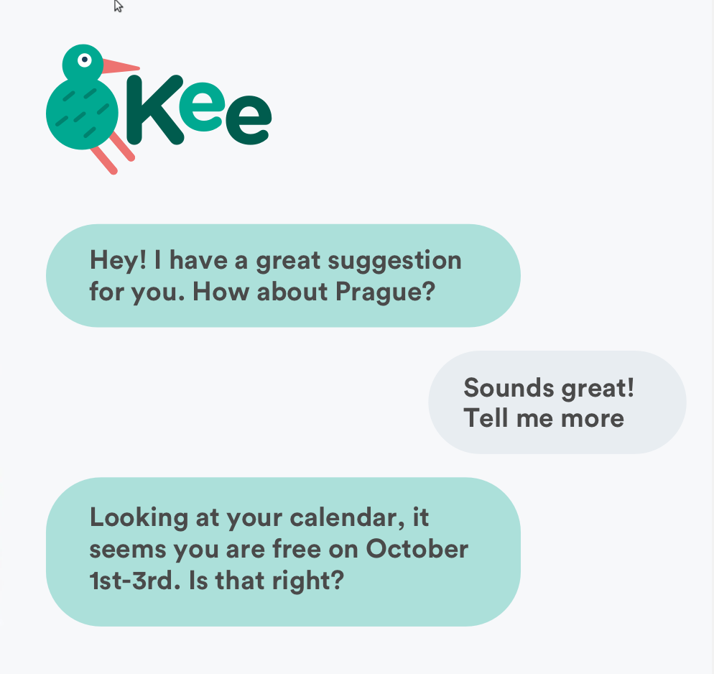
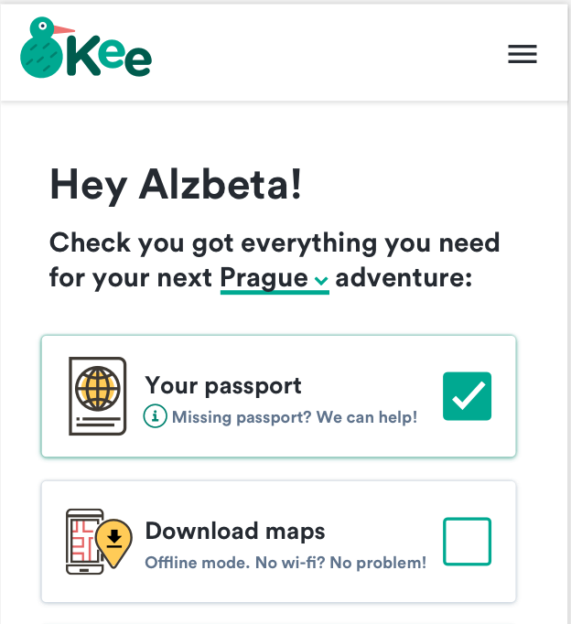
Suggestions based on your specific needs.
Notes:
Y asi es como hace meas facil el booking de un vaiej
Fondo con screenshots de vueling
UI de Kee por encima ensenando lo facil que es hacer un booking

Slide 17
Notes:
Y las actividades sugeridas para tu viaje en funcion de tus settings
Fondo de screenshots de web de actividades
UI por encima que te ensenye solo las releavntes

Slide 18
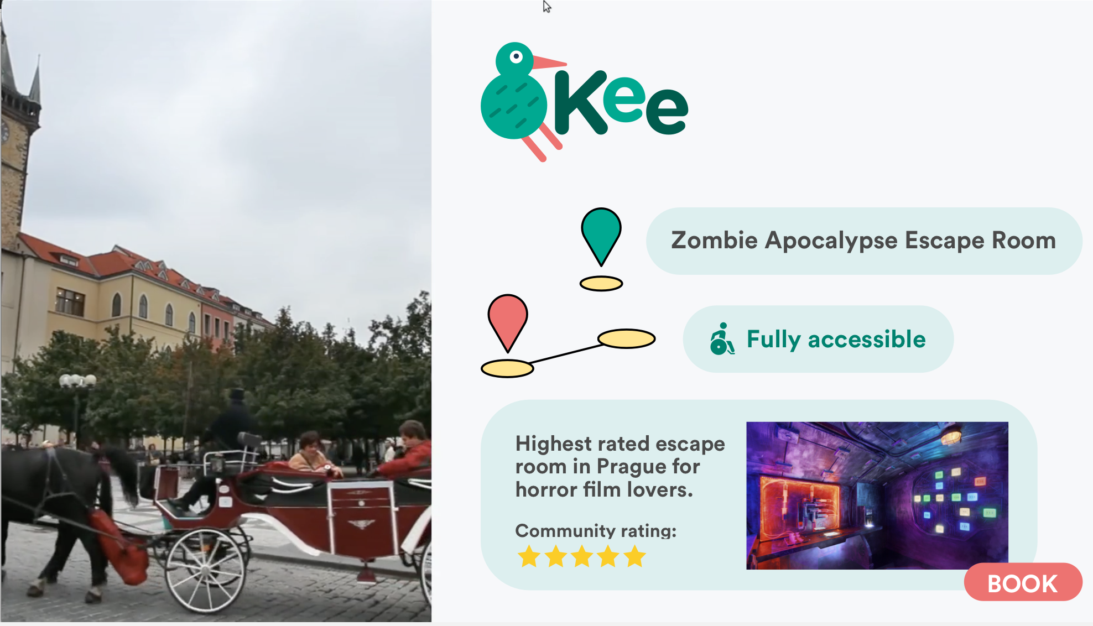
Activities you can actually do!
Notes:
Y las actividades sugeridas para tu viaje en funcion de tus settings
Fondo de screenshots de web de actividades
UI por encima que te ensenye solo las releavntes

Slide 19
Demo

Slide 20
The opportunity
Inspiration
Booking
Planning
Travelling
Review

Slide 21
The opportunity
}
Inspiration
Booking
Planning
Travelling
Review

Slide 22
BUSINESS PROBLEM
0.03%
Only of daily flight searches result in actual flight tickets sold.
Users use kiwi’s search functionality but buy elsewhere.
Notes:
Add funnel visualadd source of data

Slide 23

BUSINESS VALUE
By delivering value beyond the search functionality, users convert and use Kee every step of the way.

Slide 24
Accessibility is a spectrum that everyone is vulnerable to.
By designing for accessibility we are including every body.

Slide 25
Thanks!
Q&A

Slide 26
KIWI.COM TRAVEL HACK September 29th, 2019

Slide 27
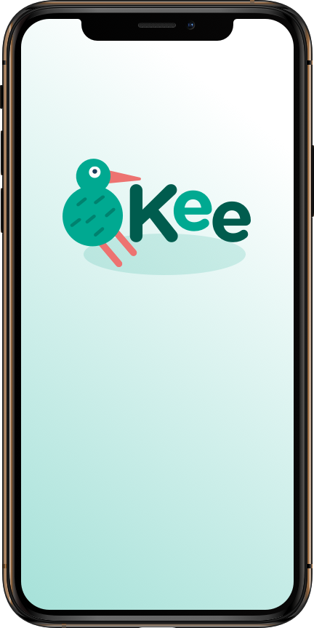




Kee is a conversational UI travel buddy that assists you every step of the way with personalised suggestions that suit your accessibility needs.
Notes:
Mention accessibility
Say text by heart, not on the slide
Screenshot of the app that shows the conversational UI travel

Slide 28


Slide 29
BUSINESS PRO
0.03%
A conversational UI
Users use kiwi’s great search functionality but buy elsewhere.
Notes:
Add funnel visualadd source of data

Slide 30
An end to end user experience
Inspiring destinations
Planning
Review
Booking
Travelling
Travel inspiration and suggested destinations
Translate text within an app
Translate text within an app
Inspiration
Booking
Planning
Travelling
Review
Translate conversations through your Android watch
Contextual
Notes:
Settings only ONCE

Slide 31


Solve for one, extend to many
Microsoft Inclusive Design

Slide 32




